Slide 1
UNIT II
Performance Enhancement Computing Cluster Computing and Sky Computing

Slide 2
  Introduction
  Scalable Parallel Computer Architecture
  A Cluster Computer and its Architecture
  Clusters Classifications
  Commodity Components for Clusters
  Network Service/Communications SW
  Cluster Middleware and Single System Image
  Resource Management and Scheduling (RMS)
  Programming Environments and Tools
  Cluster Applications
  Representative Cluster Systems
  Cluster of SMPs (CLUMPS)

Slide 3
Introduction
Need more computing power
  Improve the operating speed of processors & other components
    constrained by the speed of light, thermodynamic laws, & the high financial costs for processor fabrication
  Connect multiple processors together & coordinate their computational efforts
    parallel computers
    allow the sharing of a computational task among multiple processors

Slide 4
How to Run Applications Faster ?
There are 3 ways to improve performance:
  Work Harder
  Work Smarter
  Get Help
Computer Analogy
  Using faster hardware
  Optimized algorithms and techniques used to solve computational tasks
  Multiple computers to solve a particular task

Slide 5
Era of Computing
  Rapid technical advances
    the recent advances in VLSI technology
    software technology
      OS, PL, development methodologies, & tools
    grand challenge applications have become the main driving force
  Parallel computing
    one of the best ways to overcome the speed bottleneck of a single processor
    good price/performance ratio of a small cluster-based parallel computer

Slide 6
Two Eras of Computing
Architectures
System Software/Compiler
Applications
P.S.Es
Architectures
System Software
Applications
P.S.Es
Sequential
Era
Parallel
Era
1940 50 60 70 80 90 2000 2030
Commercialization
R & D Commodity

Slide 7
Scalable Parallel Computer Architectures
Taxonomy
  based on how processors, memory & interconnect are laid out
Massively Parallel Processors (MPP)
Symmetric Multiprocessors (SMP)
Cache-Coherent Nonuniform Memory Access (CC-NUMA)
Distributed Systems
Clusters

Slide 8
Scalable Parallel Computer Architectures
MPP
  A large parallel processing system with a shared-nothing architecture
  Consist of several hundred nodes with a high-speed interconnection network/switch
  Each node consists of a main memory & one or more processors
    Runs a separate copy of the OS
SMP
  2-64 processors today
  Shared-everything architecture
  All processors share all the global resources available
  Single copy of the OS runs on these systems

Slide 9
Scalable Parallel Computer Architectures
CC-NUMA
  a scalable multiprocessor system having a cache-coherent nonuniform memory access architecture
  every processor has a global view of all of the memory
Distributed systems
  considered conventional networks of independent computers
  have multiple system images as each node runs its own OS
  the individual machines could be combinations of MPPs, SMPs, clusters, & individual computers
Clusters
  a collection of workstations of PCs that are interconnected by a high-speed network
  work as an integrated collection of resources
  have a single system image spanning all its nodes

Slide 10
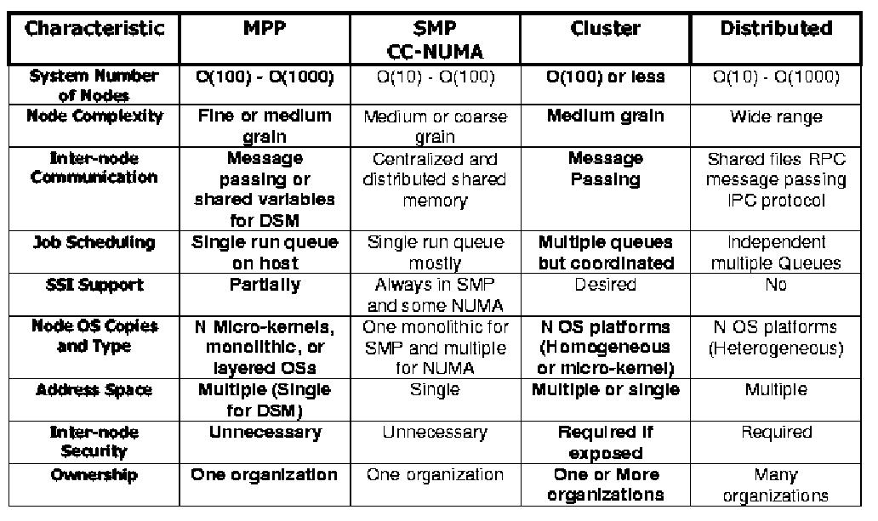
Key Characteristics of
Scalable Parallel Computers

Slide 11
Cluster Computer and its Architecture
A cluster is a type of parallel or distributed processing system, which consists of a collection of interconnected stand-alone computers cooperatively working together as a single, integrated computing resource
A node
  a single or multiprocessor system with memory, I/O facilities, & OS
  generally 2 or more computers (nodes) connected together
  in a single cabinet, or physically separated & connected via a LAN
  appear as a single system to users and applications
  provide a cost-effective way to gain features and benefits

Slide 12
Cluster Computer Architecture
Parallel Applications
Parallel Applications
Parallel Applications
Sequential Applications
Sequential Applications
Sequential Applications
Parallel Programming Environment
Cluster Middleware
(Single System Image and Availability Infrastructure)
PC/Workstation
PC/Workstation
PC/Workstation
PC/Workstation
Communications
Software
Communications
Software
Communications
Software
Communications
Software
Network Interface Hardware
Network Interface Hardware
Network Interface Hardware
Network Interface Hardware
Cluster Interconnection Network/Switch

Slide 13
Prominent Components of
Cluster Computers (I)
Multiple High Performance Computers
  PCs
  Workstations
  SMPs (CLUMPS)
  Distributed HPC Systems leading to Metacomputing

Slide 14
Prominent Components of
Cluster Computers (II)
State of the art Operating Systems
  Linux (MOSIX, Beowulf, and many more)
  Microsoft NT (Illinois HPVM, Cornell Velocity)
  SUN Solaris (Berkeley NOW, C-DAC PARAM)
  IBM AIX (IBM SP2)
  HP UX (Illinois - PANDA)
  Mach (Microkernel based OS) (CMU)
  Cluster Operating Systems (Solaris MC, SCO Unixware, MOSIX (academic project)
  OS gluing layers (Berkeley Glunix)

Slide 15
Prominent Components of
Cluster Computers (III)
High Performance Networks/Switches
  Ethernet (10Mbps),
  Fast Ethernet (100Mbps),
  Gigabit Ethernet (1Gbps)
  SCI (Scalable Coherent Interface- MPI- 12µsec latency)
  ATM (Asynchronous Transfer Mode)
  Myrinet (1.2Gbps)
  QsNet (Quadrics Supercomputing World, 5µsec latency for MPI messages)
  Digital Memory Channel
  FDDI (fiber distributed data interface)
  InfiniBand

Slide 16
Prominent Components of
Cluster Computers (IV)
Network Interface Card
  Myrinet has NIC
  User-level access support
Fast Communication Protocols and Services
  Active Messages (Berkeley)
  Fast Messages (Illinois)
  U-net (Cornell)
  XTP (Virginia)
  Virtual Interface Architecture (VIA)

Slide 17
Comparison
Myrinet
QSnet
Giganet
ServerNet2
SCI
Gigabit
Ethernet
Bandwidth
(MBytes/s)
140 – 33MHz
215 – 66 Mhz
208
~105
165
~80
30 - 50
MPI
Latency (µs)
16.5 – 33Nhz
11 – 66 Mhz
5
~20 - 40
20.2
6
100 - 200
List price/port
$1.5K
$6.5K
~$1.5K
$1.5K
~$1.5K
~$1.5K
Hardware
Availability
Now
Now
Now
Q2‘00
Now
Now
Linux Support
Now
Late‘00
Now
Q2‘00
Now
Now
Maximum
#nodes
1000’s
1000’s
1000’s
1000’s
64K
1000’s
Protocol
Implementation
Firmware on adapter
Firmware
on adapter
Firmware on adapter
Implemented in hardware
Firmware
on adapter
Implemented
in hardware
VIA support
Soon
None
NT/Linux
Done in hardware
Software
TCP/IP, VIA
NT/Linux
MPI support
3rd party
Quadrics/
Compaq
3rd Party
Compaq/3rd party
3rd Party
MPICH – TCP/IP
Notes:
$ figures as per summer (June) 00
Myrinet GM-MPI 215 MBytes/s – 11us latency - It was with a Lanai9 at 132 MHz available now.

Slide 18
Prominent Components of
Cluster Computers (V)
Cluster Middleware
  Single System Image (SSI)
  System Availability (SA) Infrastructure
Hardware
  DEC Memory Channel, DSM (Alewife, DASH), SMP Techniques
Operating System Kernel/Gluing Layers
  Solaris MC, Unixware, GLUnix
Applications and Subsystems
  Applications (system management and electronic forms)
  Runtime systems (software DSM, PFS etc.)
  Resource management and scheduling software (RMS)
    CODINE, LSF, PBS, Libra: Economy Cluster Scheduler, NQS, etc.

Slide 19
Prominent Components of
Cluster Computers (VI)
Parallel Programming Environments and Tools
  Threads (PCs, SMPs, NOW..)
    POSIX Threads
    Java Threads
  MPI
    Linux, NT, on many Supercomputers
  PVM
  Software DSMs (Shmem)
  Compilers
    C/C++/Java
    Parallel programming with C++ (MIT Press book)
  RAD (rapid application development tools)
    GUI based tools for PP modeling
  Debuggers
  Performance Analysis Tools
  Visualization Tools

Slide 20
Prominent Components of
Cluster Computers (VII)
Applications
  Sequential
  Parallel / Distributed (Cluster-aware app.)
    Grand Challenging applications
      Weather Forecasting
      Quantum Chemistry
      Molecular Biology Modeling
      Engineering Analysis (CAD/CAM)
      ……………….
    PDBs, web servers,data-mining

Slide 21
Key Operational Benefits of Clustering
High Performance
Expandability and Scalability
High Throughput
High Availability

Slide 22
Clusters Classification (I)
Application Target
  High Performance (HP) Clusters
    Grand Challenging Applications
  High Availability (HA) Clusters
    Mission Critical applications
Node Ownership
  Dedicated Clusters
  Non-dedicated clusters
    Adaptive parallel computing
    Communal multiprocessing

Slide 23
Clusters Classification (II)
Node Hardware
  Clusters of PCs (CoPs)
    Piles of PCs (PoPs)
  Clusters of Workstations (COWs)
  Clusters of SMPs (CLUMPs)
Node Operating System
  Linux Clusters (e.g., Beowulf)
  Solaris Clusters (e.g., Berkeley NOW)
  NT Clusters (e.g., HPVM)
  AIX Clusters (e.g., IBM SP2)
  SCO/Compaq Clusters (Unixware)
  Digital VMS Clusters
  HP-UX clusters
  Microsoft Wolfpack clusters

Slide 24
Clusters Classification (III)
Node Configuration
  Homogeneous Clusters
    All nodes will have similar architectures and run the same OSs
  Heterogeneous Clusters
    All nodes will have different architectures and run different Oss
Levels of Clustering
  Group Clusters (#nodes: 2-99)
    Nodes are connected by SAN like Myrinet
  Departmental Clusters (#nodes: 10s to 100s)
  Organizational Clusters (#nodes: many 100s)
  National Metacomputers (WAN/Internet-based)
  International Metacomputers (Internet-based, #nodes: 1000s to many millions)
    Metacomputing / Grid Computing
    Web-based Computing
    Agent Based Computing
      Java plays a major in web and agent based computing

Slide 25
Commodity Components for Clusters (I)
Processors
  Intel x86 Processors
    Pentium Pro and Pentium Xeon
    AMD x86, Cyrix x86, etc.
  Digital Alpha
    Alpha 21364 processor integrates processing, memory controller, network interface into a single chip
  IBM PowerPC
  Sun SPARC
  SGI MIPS
  HP PA
  Berkeley Intelligent RAM (IRAM) integrates processor and DRAM onto a single chip

Slide 26
Commodity Components for Clusters (II)
Memory and Cache
  Standard Industry Memory Module (SIMM)
  Extended Data Out (EDO)
    Allow next access to begin while the previous data is still being read
  Fast page
    Allow multiple adjacent accesses to be made more efficiently
  Access to DRAM is extremely slow compared to the speed of the processor
    the very fast memory used for Cache is expensive & cache control circuitry becomes more complex as the size of the cache grows
  Within Pentium-based machines, uncommon to have a 64-bit wide memory bus as well as a chip set that support 2Mbytes of external cache

Slide 27
Commodity Components for Clusters (III)
Disk and I/O
  Overall improvement in disk access time has been less than 10% per year
  Amdahl’s law
    Speed-up obtained by from faster processors is limited by the slowest system component
  Parallel I/O
    Carry out I/O operations in parallel, supported by parallel file system based on hardware or software RAID

Slide 28
Commodity Components for Clusters (IV)
System Bus
  ISA bus (AT bus)
    Clocked at 5MHz and 8 bits wide
    Clocked at 13MHz and 16 bits wide
  VESA bus
    32 bits bus matched system’s clock speed
  PCI bus
    133Mbytes/s transfer rate
    Adopted both in Pentium-based PC and non-Intel platform (e.g., Digital Alpha Server)

Slide 29
Commodity Components for Clusters (V)
Cluster Interconnects
  Communicate over high-speed networks using a standard networking protocol such as TCP/IP or a low-level protocol such as AM
  Standard Ethernet
    10 Mbps
    cheap, easy way to provide file and printer sharing
    bandwidth & latency are not balanced with the computational power
  Ethernet, Fast Ethernet, and Gigabit Ethernet
    Fast Ethernet – 100 Mbps
    Gigabit Ethernet
      preserve Ethernet’s simplicity
      deliver a very high bandwidth to aggregate multiple Fast Ethernet segments

Slide 30
Commodity Components for Clusters (VI)
Cluster Interconnects
  Asynchronous Transfer Mode (ATM)
    Switched virtual-circuit technology
    Cell (small fixed-size data packet)
    use optical fiber - expensive upgrade
    telephone style cables (CAT-3) & better quality cable (CAT-5)
  Scalable Coherent Interfaces (SCI)
    IEEE 1596-1992 standard aimed at providing a low-latency distributed shared memory across a cluster
    Point-to-point architecture with directory-based cache coherence
      reduce the delay interprocessor communication
      eliminate the need for runtime layers of software protocol-paradigm translation
      less than 12 usec zero message-length latency on Sun SPARC
    Designed to support distributed multiprocessing with high bandwidth and low latency
    SCI cards for SPARC’s SBus and PCI-based SCI cards from Dolphin
    Scalability constrained by the current generation of switches & relatively expensive components

Slide 31
Commodity Components for Clusters (VII)
Cluster Interconnects
  Myrinet
    1.28 Gbps full duplex interconnection network
    Use low latency cut-through routing switches, which is able to offer fault tolerance by automatic mapping of the network configuration
    Support both Linux & NT
    Advantages
      Very low latency (5μs, one-way point-to-point)
      Very high throughput
      Programmable on-board processor for greater flexibility
    Disadvantages
      Expensive: $1500 per host
      Complicated scaling: switches with more than 16 ports are unavailable

Slide 32
Commodity Components for Clusters (VIII)
Operating Systems
  2 fundamental services for users
    make the computer hardware easier to use
      create a virtual machine that differs markedly from the real machine
    share hardware resources among users
      Processor - multitasking
  The new concept in OS services
    support multiple threads of control in a process itself
      parallelism within a process
      multithreading
      POSIX thread interface is a standard programming environment
  Trend
    Modularity – MS Windows, IBM OS/2
    Microkernel – provide only essential OS services
      high level abstraction of OS portability

Slide 33
Commodity Components for Clusters (IX)
Operating Systems
  Linux
    UNIX-like OS
    Runs on cheap x86 platform, yet offers the power and flexibility of UNIX
    Readily available on the Internet and can be downloaded without cost
    Easy to fix bugs and improve system performance
    Users can develop or fine-tune hardware drivers which can easily be made available to other users
    Features such as preemptive multitasking, demand-page virtual memory, multiuser, multiprocessor support

Slide 34
Commodity Components for Clusters (X)
Operating Systems
  Solaris
    UNIX-based multithreading and multiuser OS
    support Intel x86 & SPARC-based platforms
    Real-time scheduling feature critical for multimedia applications
    Support two kinds of threads
      Light Weight Processes (LWPs)
      User level thread
    Support both BSD and several non-BSD file system
      CacheFS
      AutoClient
      TmpFS: uses main memory to contain a file system
      Proc file system
      Volume file system
    Support distributed computing & is able to store & retrieve distributed information
    OpenWindows allows application to be run on remote systems

Slide 35
Commodity Components for Clusters (XI)
Operating Systems
  Microsoft Windows NT (New Technology)
    Preemptive, multitasking, multiuser, 32-bits OS
    Object-based security model and special file system (NTFS) that allows permissions to be set on a file and directory basis
    Support multiple CPUs and provide multitasking using symmetrical multiprocessing
    Support different CPUs and multiprocessor machines with threads
    Have the network protocols & services integrated with the base OS
      several built-in networking protocols (IPX/SPX., TCP/IP, NetBEUI), & APIs (NetBIOS, DCE RPC, Window Sockets (Winsock))

Slide 36
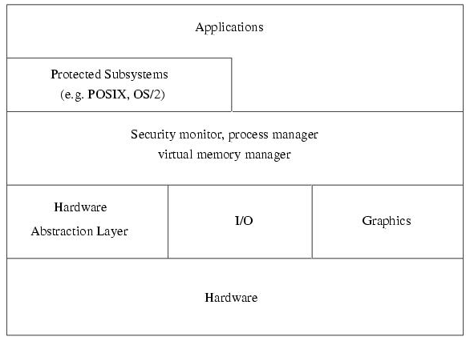
Windows NT 4.0 Architecture

Slide 37
Network Services/ Communication SW
Communication infrastructure support protocol for
  Bulk-data transport
  Streaming data
  Group communications
Communication service provide cluster with important QoS parameters
  Latency
  Bandwidth
  Reliability
  Fault-tolerance
  Jitter control
Network service are designed as hierarchical stack of protocols with relatively low-level communication API, provide means to implement wide range of communication methodologies
  RPC
  DSM
  Stream-based and message passing interface (e.g., MPI, PVM)

Slide 38
What is Single System Image (SSI)?
A single system image is the illusion, created by software or hardware, that presents a collection of resources as one, more powerful resource.
SSI makes the cluster appear like a single machine to the user, to applications, and to the network.
A cluster without a SSI is not a cluster

Slide 39
Cluster Middleware & SSI
SSI
  Supported by a middleware layer that resides between the OS and user-level environment
  Middleware consists of essentially 2 sublayers of SW infrastructure
    SSI infrastructure
      Glue together OSs on all nodes to offer unified access to system resources
    System availability infrastructure
      Enable cluster services such as checkpointing, automatic failover, recovery from failure, & fault-tolerant support among all nodes of the cluster

Slide 40
Single System Image Boundaries
Every SSI has a boundary
SSI support can exist at different levels within a system, one able to be build on another

Slide 41
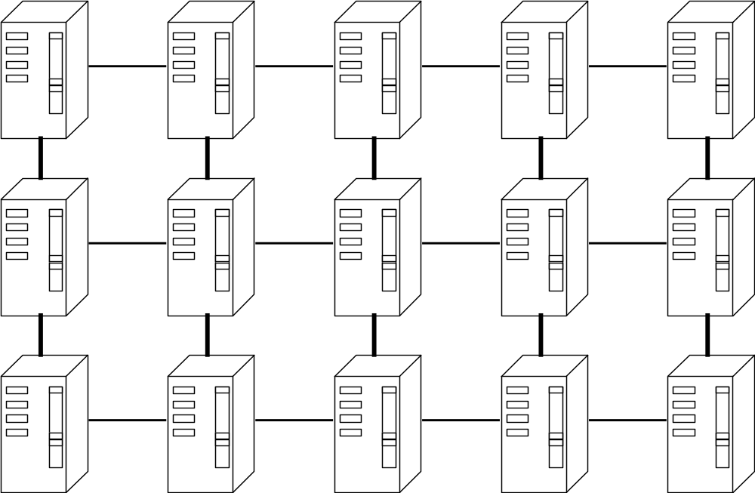
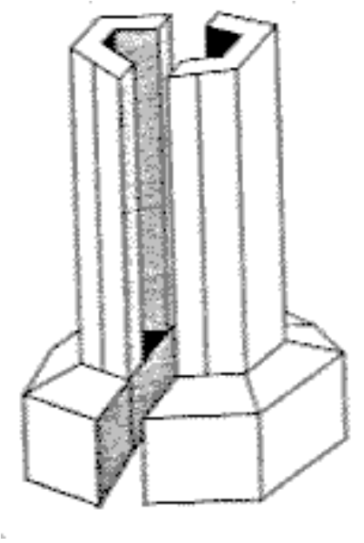
SSI Boundaries -- an applications SSI boundary
Batch System
SSI
Boundary

Slide 42
SSI Levels/Layers
Application and Subsystem Level
Operating System Kernel Level
Hardware Level

Slide 43
SSI at Hardware Layer
Level
Examples
Boundary
Importance
Application and Subsystem Level
Operating System Kernel Level
memory
SCI, DASH
memory space
better communica-
tion and synchro-
nization
memory
and I/O
SCI, SMP techniques
memory and I/O
device space
lower overhead
cluster I/O
(c) In search of clusters

Slide 44
SSI at Operating System Kernel or Gluing Layer
Level
Examples
Boundary
Importance
Kernel/
OS Layer
Solaris MC, Unixware
MOSIX, Sprite,Amoeba
/ GLUnix
each name space:
files, processes,
pipes, devices, etc.
kernel support for
applications, adm
subsystems
kernel
interfaces
UNIX (Sun) vnode,
Locus (IBM) vproc
type of kernel
objects: files,
processes, etc.
modularizes SSI
code within
kernel
virtual
memory
none supporting
operating system kernel
each distributed
virtual memory
space
may simplify
implementation
of kernel objects
microkernel
Mach, PARAS, Chorus,
OSF/1AD, Amoeba
each service
outside the
microkernel
implicit SSI for
all system services
(c) In search of clusters

Slide 45
SSI at Application and Subsystem Layer (Middleware)
Level
Examples
Boundary
Importance
application
cluster batch system,
system management
an application
what a user
wants
subsystem
distributed DB,
OSF DME, Lotus
Notes, MPI, PVM
a subsystem
SSI for all
applications of
the subsystem
file system
Sun NFS, OSF,
DFS, NetWare,
and so on
shared portion of
the file system
implicitly supports
many applications
and subsystems
toolkit
OSF DCE, Sun
ONC+, Apollo
Domain
explicit toolkit
facilities: user,
service name,time
best level of
support for heter-
ogeneous system
(c) In search of clusters

Slide 46
Single System Image Benefits
Provide a simple, straightforward view of all system resources and activities, from any node of the cluster
Free the end user from having to know where an application will run
Free the operator from having to know where a resource is located
Let the user work with familiar interface and commands and allows the administrators to manage the entire clusters as a single entity
Reduce the risk of operator errors, with the result that end users see improved reliability and higher availability of the system

Slide 47
Single System Image Benefits (Cont’d)
Allowing centralize/decentralize system management and control to avoid the need of skilled administrators from system administration
Present multiple, cooperating components of an application to the administrator as a single application
Greatly simplify system management
Provide location-independent message communication
Help track the locations of all resource so that there is no longer any need for system operators to be concerned with their physical location
Provide transparent process migration and load balancing across nodes.
Improved system response time and performance

Slide 48
Middleware Design Goals
Complete Transparency in Resource Management
  Allow user to use a cluster easily without the knowledge of the underlying system architecture
  The user is provided with the view of a globalized file system, processes, and network
Scalable Performance
  Can easily be expanded, their performance should scale as well
  To extract the max performance, the SSI service must support load balancing & parallelism by distributing workload evenly among nodes
Enhanced Availability
  Middleware service must be highly available at all times
  At any time, a point of failure should be recoverable without affecting a user’s application
    Employ checkpointing & fault tolerant technologies
  Handle consistency of data when replicated

Slide 49
SSI Support Services
Single Entry Point
  telnet cluster.myinstitute.edu
  telnet node1.cluster. myinstitute.edu
Single File Hierarchy: xFS, AFS, Solaris MC Proxy
Single Management and Control Point: Management from single GUI
Single Virtual Networking
Single Memory Space - Network RAM / DSM
Single Job Management: GLUnix, Codine, LSF
Single User Interface: Like workstation/PC windowing environment (CDE in Solaris/NT), may it can use Web technology

Slide 50
Availability Support Functions
Single I/O Space (SIOS):
  any node can access any peripheral or disk devices without the knowledge of physical location.
Single Process Space (SPS)
  Any process on any node create process with cluster wide process wide and they communicate through signal, pipes, etc, as if they are one a single node.
Checkpointing and Process Migration.
  Saves the process state and intermediate results in memory to disk to support rollback recovery when node fails
  PM for dynamic load balancing among the cluster nodes

Slide 51
Resource Management and Scheduling

Slide 52
Resource Management and Scheduling (RMS)
RMS is the act of distributing applications among computers to maximize their throughput
Enable the effective and efficient utilization of the resources available
Software components
  Resource manager
    Locating and allocating computational resource, authentication, process creation and migration
  Resource scheduler
    Queuing applications, resource location and assignment. It instructs resource manager what to do when (policy)
Reasons for using RMS
  Provide an increased, and reliable, throughput of user applications on the systems
  Load balancing
  Utilizing spare CPU cycles
  Providing fault tolerant systems
  Manage access to powerful system, etc
Basic architecture of RMS: client-server system

Slide 53
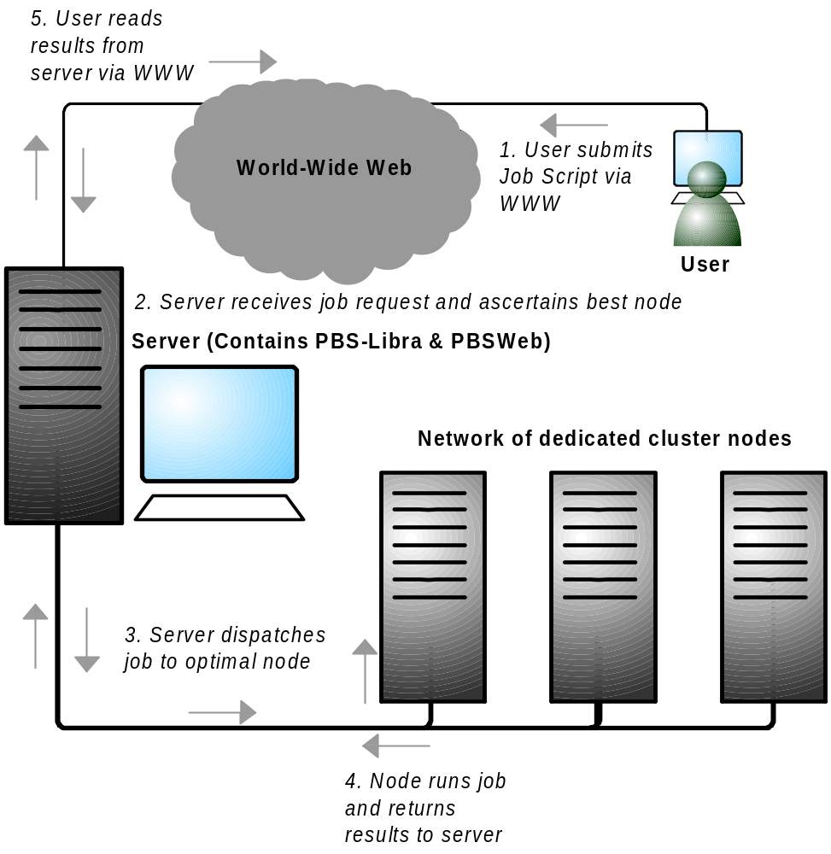
RMS Components

Slide 54

Libra: An example cluster scheduler
User
Cluster Management System
(PBS)
Application
Job
Input
Control
Job Dispatch Control
(node 1)
Application
Budget
Check
Control
Best
Node
Evaluator
User
.
(node 2)
.
.
Deadline Control
Node Querying Module
(node N)
Scheduler (Libra)
Cluster Worker Nodes
with node monitor (pbs_mom)
Server: Master Node

Slide 55
Services provided by RMS
Process Migration
  Computational resource has become too heavily loaded
  Fault tolerant concern
Checkpointing
Scavenging Idle Cycles
  70% to 90% of the time most workstations are idle
Fault Tolerance
Minimization of Impact on Users
Load Balancing
Multiple Application Queues

Slide 56
Some Popular
Resource Management Systems
Project | Commercial Systems - URL
LSF | http://www.platform.com/
SGE | http://www.sun.com/grid/
Easy-LL | http://www.tc.cornell.edu/UserDoc/SP/LL12/Easy/
NQE | http://www.cray.com/products/software/nqe/
 | Public Domain System - URL
Condor | http://www.cs.wisc.edu/condor/
GNQS | http://www.gnqs.org/
DQS | http://www.scri.fsu.edu/~pasko/dqs.html
PBS | http://pbs.mrj.com/
Libra | http://www.buyya.com/libra or www.gridbus.org

Slide 57
Cluster Programming

Slide 58
Cluster Programming Environments
Shared Memory Based
  DSM
  Threads/OpenMP (enabled for clusters)
  Java threads (HKU JESSICA, IBM cJVM)
Message Passing Based
  PVM (PVM)
  MPI (MPI)
Parametric Computations
  Nimrod-G
Automatic Parallelising Compilers
Parallel Libraries & Computational Kernels (e.g., NetSolve)
Notes:
14

Slide 59


Levels of Parallelism
Code-Granularity
Code Item
Large grain
(task level)
Program
Medium grain
(control level)
Function (thread)
Fine grain
(data level)
Loop (Compiler)
Very fine grain
(multiple issue)
With hardware
PVM/MPI
Task i-l
Task i
Task i+1
func1 ( )
{
....
....
}
func2 ( )
{
....
....
}
func3 ( )
{
....
....
}
Threads
Compilers
a ( 0 ) =..
b ( 0 ) =..
a ( 1 )=..
b ( 1 )=..
a ( 2 )=..
b ( 2 )=..
CPU
+
x
Load

Slide 60
Programming Environments and Tools (I)
Threads (PCs, SMPs, NOW..)
  In multiprocessor systems
    Used to simultaneously utilize all the available processors
  In uniprocessor systems
    Used to utilize the system resources effectively
  Multithreaded applications offer quicker response to user input and run faster
  Potentially portable, as there exists an IEEE standard for POSIX threads interface (pthreads)
  Extensively used in developing both application and system software

Slide 61
Programming Environments and Tools (II)
Message Passing Systems (MPI and PVM)
  Allow efficient parallel programs to be written for distributed memory systems
  2 most popular high-level message-passing systems – PVM & MPI
  PVM
    both an environment & a message-passing library
  MPI
    a message passing specification, designed to be standard for distributed memory parallel computing using explicit message passing
    attempt to establish a practical, portable, efficient, & flexible standard for message passing
    generally, application developers prefer MPI, as it is fast becoming the de facto standard for message passing

Slide 62
Programming Environments and Tools (III)
Distributed Shared Memory (DSM) Systems
  Message-passing
    the most efficient, widely used, programming paradigm on distributed memory system
    complex & difficult to program
  Shared memory systems
    offer a simple and general programming model
    but suffer from scalability
  DSM on distributed memory system
    alternative cost-effective solution
    Software DSM
      Usually built as a separate layer on top of the comm interface
      Take full advantage of the application characteristics: virtual pages, objects, & language types are units of sharing
      TreadMarks, Linda
    Hardware DSM
      Better performance, no burden on user & SW layers, fine granularity of sharing, extensions of the cache coherence scheme, & increased HW complexity
      DASH, Merlin

Slide 63
Programming Environments and Tools (IV)
Parallel Debuggers and Profilers
  Debuggers
    Very limited
    HPDF (High Performance Debugging Forum) as Parallel Tools Consortium project in 1996
      Developed a HPD version specification, which defines the functionality, semantics, and syntax for a commercial-line parallel debugger
  TotalView
    A commercial product from Dolphin Interconnect Solutions
    The only widely available GUI-based parallel debugger that supports multiple HPC platforms
    Only used in homogeneous environments, where each process of the parallel application being debugged must be running under the same version of the OS

Slide 64
Functionality of Parallel Debugger
Managing multiple processes and multiple threads within a process
Displaying each process in its own window
Displaying source code, stack trace, and stack frame for one or more processes
Diving into objects, subroutines, and functions
Setting both source-level and machine-level breakpoints
Sharing breakpoints between groups of processes
Defining watch and evaluation points
Displaying arrays and its slices
Manipulating code variable and constants

Slide 65
Programming Environments and Tools (V)
Performance Analysis Tools
  Help a programmer to understand the performance characteristics of an application
  Analyze & locate parts of an application that exhibit poor performance and create program bottlenecks
  Major components
    A means of inserting instrumentation calls to the performance monitoring routines into the user’s applications
    A run-time performance library that consists of a set of monitoring routines
    A set of tools for processing and displaying the performance data
  Issue with performance monitoring tools
    Intrusiveness of the tracing calls and their impact on the application performance
    Instrumentation affects the performance characteristics of the parallel application and thus provides a false view of its performance behavior

Slide 66
Performance Analysis and Visualization Tools
Tool | Supports | URL
AIMS | Instrumentation, monitoring library, analysis | http://science.nas.nasa.gov/Software/AIMS
MPE | Logging library and snapshot performance visualization | http://www.mcs.anl.gov/mpi/mpich
Pablo | Monitoring library and analysis | http://www-pablo.cs.uiuc.edu/Projects/Pablo/
Paradyn | Dynamic instrumentation running analysis | http://www.cs.wisc.edu/paradyn
SvPablo | Integrated instrumentor, monitoring library and analysis | http://www-pablo.cs.uiuc.edu/Projects/Pablo/
Vampir | Monitoring library performance visualization | http://www.pallas.de/pages/vampir.htm
Dimenmas | Performance prediction for message passing programs | http://www.pallas.com/pages/dimemas.htm
Paraver | Program visualization and analysis | http://www.cepba.upc.es/paraver

Slide 67
Programming Environments and Tools (VI)
Cluster Administration Tools
  Berkeley NOW
    Gather & store data in a relational DB
    Use Java applet to allow users to monitor a system
  SMILE (Scalable Multicomputer Implementation using Low-cost Equipment)
    Called K-CAP
    Consist of compute nodes, a management node, & a client that can control and monitor the cluster
    K-CAP uses a Java applet to connect to the management node through a predefined URL address in the cluster
  PARMON
    A comprehensive environment for monitoring large clusters
    Use client-server techniques to provide transparent access to all nodes to be monitored
    parmon-server & parmon-client

Slide 68
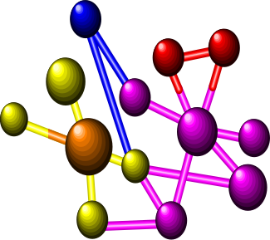








Need of more Computing Power:
Grand Challenge Applications
Solving technology problems using computer modeling, simulation and analysis
Geographic
Information
Systems
Life Sciences
Aerospace
CAD/CAM
Digital Biology
Military Applications

Slide 69
Case Studies of Some Cluster Systems

Slide 70
Representative Cluster Systems (I)
The Berkeley Network of Workstations (NOW) Project
  Demonstrate building of a large-scale parallel computer system using mass produced commercial workstations & the latest commodity switch-based network components
  Interprocess communication
    Active Messages (AM)
      basic communication primitives in Berkeley NOW
      A simplified remote procedure call that can be implemented efficiently on a wide range of hardware
  Global Layer Unix (GLUnix)
    An OS layer designed to provide transparent remote execution, support for interactive parallel & sequential jobs, load balancing, & backward compatibility for existing application binaries
    Aim to provide a cluster-wide namespace and uses Network PIDs (NPIDs), and Virtual Node Numbers (VNNs)

Slide 71
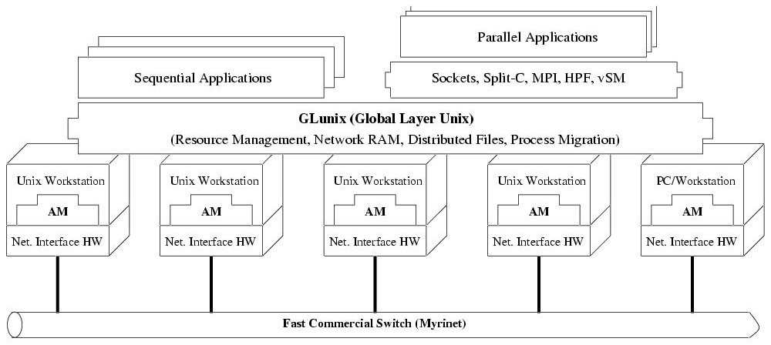
Architecture of NOW System

Slide 72
Representative Cluster Systems (II)
The Berkeley Network of Workstations (NOW) Project
  Network RAM
    Allow to utilize free resources on idle machines as a paging device for busy machines
    Serverless
      any machine can be a server when it is idle, or a client when it needs more memory than physically available
  xFS: Serverless Network File System
    A serverless, distributed file system, which attempt to have low latency, high bandwidth access to file system data by distributing the functionality of the server among the clients
    The function of locating data in xFS is distributed by having each client responsible for servicing requests on a subset of the files
    File data is striped across multiple clients to provide high bandwidth

Slide 73
Representative Cluster Systems (III)
The High Performance Virtual Machine (HPVM) Project
  Deliver supercomputer performance on a low cost COTS system
  Hide the complexities of a distributed system behind a clean interface
  Challenges addressed by HPVM
    Delivering high performance communication to standard, high-level APIs
    Coordinating scheduling and resource management
    Managing heterogeneity

Slide 74
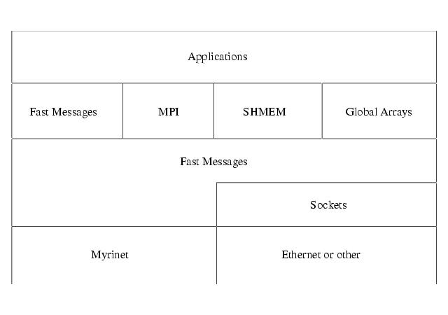
HPVM Layered Architecture

Slide 75
Representative Cluster Systems (IV)
The High Performance Virtual Machine (HPVM) Project
  Fast Messages (FM)
    A high bandwidth & low-latency comm protocol, based on Berkeley AM
    Contains functions for sending long and short messages & for extracting messages from the network
    Guarantees and controls the memory hierarchy
    Guarantees reliable and ordered packet delivery as well as control over the scheduling of communication work
    Originally developed on a Cray T3D & a cluster of SPARCstations connected by Myrinet hardware
    Low-level software interface that delivery hardware communication performance
    High-level layers interface offer greater functionality, application portability, and ease of use

Slide 76
Representative Cluster Systems (V)
The Beowulf Project
  Investigate the potential of PC clusters for performing computational tasks
  Refer to a Pile-of-PCs (PoPC) to describe a loose ensemble or cluster of PCs
  Emphasize the use of mass-market commodity components, dedicated processors, and the use of a private communication network
  Achieve the best overall system cost/performance ratio for the cluster

Slide 77
Representative Cluster Systems (VI)
The Beowulf Project
  System Software
    Grendel
      the collection of software tools
      resource management & support distributed applications
    Communication
      through TCP/IP over Ethernet internal to cluster
      employ multiple Ethernet networks in parallel to satisfy the internal data transfer bandwidth required
      achieved by ‘channel binding’ techniques
    Extend the Linux kernel to allow a loose ensemble of nodes to participate in a number of global namespaces
    Two Global Process ID (GPID) schemes
      Independent of external libraries
      GPID-PVM compatible with PVM Task ID format & uses PVM as its signal transport

Slide 78
Representative Cluster Systems (VII)
Solaris Multi-Computer: A High Performance Operating System for Clusters
  A distributed OS for a multicomputer, a cluster of computing nodes connected by a high-speed interconnect
  Provide a single system image, making the cluster appear like a single machine to the user, to applications, and the the network
  Built as a globalization layer on top of the existing Solaris kernel
  Interesting features
    extends existing Solaris OS
    preserves the existing Solaris ABI/API compliance
    provides support for high availability
    uses C++, IDL, CORBA in the kernel
    leverages spring technology

Slide 79
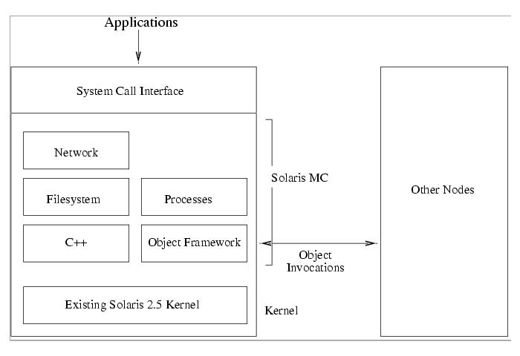
Solaris MC Architecture

Slide 80
Representative Cluster Systems (VIII)
Solaris MC: A High Performance Operating System for Clusters
  Use an object-oriented framework for communication between nodes
    Based on CORBA
    Provide remote object method invocations
    Provide object reference counting
    Support multiple object handlers
  Single system image features
    Global file system
      Distributed file system, called ProXy File System (PXFS), provides a globalized file system without need for modifying the existing file system
    Globalized process management
    Globalized network and I/O

Slide 81
Cluster System Comparison Matrix
Project | Platform | Communications | OS | Other
Beowulf | PCs | Multiple Ethernet with TCP/IP | Linux and Grendel | MPI/PVM. Sockets and HPF
Berkeley Now | Solaris-based PCs and workstations | Myrinet and Active Messages | Solaris + GLUnix + xFS | AM, PVM, MPI, HPF, Split-C
HPVM | PCs | Myrinet with Fast Messages | NT or Linux connection and global resource manager + LSF | Java-fronted, FM, Sockets, Global Arrays, SHEMEM and MPI
Solaris MC | Solaris-based PCs and workstations | Solaris-supported | Solaris + Globalization layer | C++ and CORBA

Slide 82
Cluster of SMPs (CLUMPS)
Clusters of multiprocessors (CLUMPS)
  To be the supercomputers of the future
  Multiple SMPs with several network interfaces can be connected using high performance networks
  2 advantages
    Benefit from the high performance, easy-to-use-and program SMP systems with a small number of CPUs
    Clusters can be set up with moderate effort, resulting in easier administration and better support for data locality inside a node

Slide 83
What Is a Heterogeneous Cluster?
Node A
CPU: Fast
OS: Linux
Node B
CPU: Medium
OS: Linux
Node C
CPU: GPU
OS: Linux
Node D
Different CPU / OS
Cluster Interconnect
Heterogeneous Clusters consists of nodes differ in processor architecture/speed, memory, accelerators, operating system, or network/storage capability.
The key consequence: identical work may take different amounts of time on different nodes.
Notes:
Draw attention to the different node capabilities. Ask: if four equal tasks are assigned one per node, will they finish together? No. The slowest node can delay a synchronized application.

Slide 84
Homogeneous vs. Heterogeneous
Homogeneous cluster
  Similar hardware and software configuration
  Simpler scheduling and performance prediction
  Equal-size task partitions are often reasonable
Heterogeneous cluster
  Different processors, memory, accelerators, OSs or network characteristics
  Scheduling must consider node capability
  Performance prediction and portability are harder
Homogeneous
CPU
CPU
CPU
CPU
Similar nodes → simpler scheduling
Heterogeneous
CPU
GPU
Notes:
Use this slide to establish the comparison. Homogeneity reduces variability; heterogeneity can improve flexibility and resource utilization but increases management and scheduling complexity.

Slide 85
Sources of Heterogeneity
Processor heterogeneity — different CPU generations, core counts, clock rates, or architectures
Accelerator heterogeneity — CPU-only, GPU, FPGA, or other accelerators
Memory heterogeneity — different capacity or bandwidth
Operating-system heterogeneity — different OS versions/platforms
Network heterogeneity — different link speeds/latencies
Storage heterogeneity — different capacity, IOPS, or file-system support
Notes:
Give a practical example: an old workstation, a modern multicore server, and a GPU server may all belong to the same cluster. Each resource type can be useful, but jobs must be matched appropriately.

Slide 86
Why Scheduling Becomes Difficult
Fast node
2× speed
GPU
10× for GPU task
Equal task counts do not imply equal completion times.
A good scheduler considers capability, task type, communication cost, and current load.
Goal: maximize utilization while minimizing completion time and bottlenecks.
Job
100 tasks
Medium
1× speed
Slow node
0.5× speed
Nodes do not have identical computational capabilities.
Equal distribution of work may result in poor performance.
Work should be assigned according to the processing capability of each node.
Notes:
Explain that task assignment is not simply round-robin. A GPU-friendly task may be sent to the GPU, while a serial or branch-heavy task may be better on a CPU. Communication cost must also be considered.

Slide 87
Example: Capability-Aware Load Balancing
Suppose four nodes have relative compute capacities: 4, 2, 2, and 1.
Total capacity = 9 units.
For a 90-unit workload, an ideal proportional split is approximately 40, 20, 20, and 10 units.
Naïve equal split (22.5 each) overloads the slow node and underuses the fast node.
N1
4×
N2
2×
90 units
→ 40/20/20/10
N3
2×
N4
1×
Notes:
Walk through the arithmetic. The example is conceptual: real schedulers also account for task dependencies, communication, memory, data locality, and current load.

Slide 88
Heterogeneous Cluster: Advantages and Challenges
Advantages
  Reuse existing hardware
  Match specialized jobs to suitable resources
  Add new technology incrementally
  Potentially higher aggregate performance
Challenges
  Complex scheduling and resource discovery
  Portability and software compatibility
  Different performance characteristics
  Harder monitoring, tuning, and administration
Notes:
Ask students to suggest one application that benefits from a GPU and one that may not. Use their answers to reinforce the idea of resource matching.

Slide 89
Security in Cluster Computing
A cluster is a networked collection of machines; compromise of one component can threaten shared resources.
Connecting all the nodes directly to the external network may cause two main problems.
First, we make temporary changes and forget to restore them.
Second, systems tend to have information leaks. The operating system and its version can be easily guessed just with IP access, even with harmless services running and almost all operating system have serious security problems in their IP stack in the recent history.
Security objectives:
  Confidentiality — protect data and credentials
  Integrity — prevent unauthorized modification
  Availability — keep services and resources usable
  Accountability — identify and audit actions
Users / Applications
Cluster Services
Compute + Storage Nodes
Notes:
Introduce security as a system property rather than a single firewall or password. In a cluster, identities, services, nodes, networks, and shared data all need protection.

Slide 90
Security Policies
Define who may access the cluster and what they may do.
  Authentication: verify identity.
  Authorization: decide permitted actions.
Access control: restrict files, jobs, services, and administrative functions.
Auditing and monitoring: record important security events.
Policy principle: least privilege — give users and services only the access they need.
A security policy should clearly define:
Who → can access → what resource → under what conditions
Notes:
Distinguish authentication from authorization: authentication asks 'Who are you?' while authorization asks 'What are you allowed to do?'. Give the example of a student who can submit jobs but cannot change cluster configuration.

Slide 91
Finding the Weakest Point in NOWs and COWs
Node 1
Internet / Users
Front-End
Shared Storage
Node 2
Node 3
Clusters may be constructed from Networks of Workstations (NOWs) or Clusters of Workstations (COWs).
Security analysis should identify the weakest component in the system.
Potential weak points: exposed services, weak credentials, unpatched nodes, insecure network paths, shared storage, or poorly protected management interfaces.
Security assessment should consider the whole path, not only the compute nodes.
Notes:
Explain the weakest-point principle. A highly secure compute node does not compensate for a vulnerable login service or shared storage system. In a NOW/COW environment, many machines and network paths must be considered.

Slide 92
A Little Help from a Front-End
Compute Nodes
Users
Secure Front-End
Authentication
Job Submission
Compute Nodes
Storage / Services
A front-end node can be used as a controlled gateway between users and the internal cluster.
Can centralize User authentication, User login, Job submission, Resource access control, Monitoring, Administration, Restricting direct access to compute nodes
External Users → Front-End → Internal Cluster Nodes. This architecture reduces the need for direct user access to every compute node.
Notes:
Explain the front-end as a security boundary and management point. It does not make the cluster automatically secure; it must itself be hardened and monitored.

Slide 93
Front-End Example: Job Submission
Step 1 — User authenticates to the front-end.
Step 2 — User submits a parallel job.
Step 3 — Scheduler validates resources and policy.
Step 4 — Job is dispatched to selected compute nodes.
Step 5 — Results return through approved services.
Security benefit: fewer exposed management paths to worker nodes.
Authenticate
Submit
Validate
Dispatch
Collect
Notes:
Use this as a classroom walkthrough. Ask students at which steps authorization and auditing can be applied. Highlight that the front-end is a controlled gateway, not merely a login screen.

Slide 94
Security vs. Performance Trade-offs
Security controls can add CPU, memory, storage, and network overhead.
Encryption protects communication but consumes computation and bandwidth.
Frequent authentication/authorization checks can add latency.
Monitoring and intrusion detection consume resources.
The design goal is not 'maximum security at any cost' but an appropriate security level for the workload and threat model.
More Security
Overhead / Latency
Performance Impact
Notes:
Ask: Should every cluster use the strongest possible encryption and monitoring settings? Lead students toward a risk-based answer. Security mechanisms should be selected based on data sensitivity, threat exposure, performance requirements, and operational constraints.

Slide 95
Example: Choosing a Security Level
Scenario A: public research cluster with sensitive unpublished data
  Strong authentication, protected communication, strict access control, auditing
Scenario B: isolated teaching lab with non-sensitive sample workloads
  Still require authentication and access control, but controls may be simpler
Inference: security requirements depend on assets, threats, exposure, and consequences of failure. Highly secure configurations may introduce overhead, while minimizing security mechanisms can increase vulnerability.
Security Mechanism | Possible Performance Impact
Encryption | CPU/network overhead
Authentication | Additional processing
Access checking | Additional system operations
Secure communication | Communication overhead
Intrusion detection | Monitoring overhead
Strong isolation | Reduced resource sharing
Notes:
Emphasize risk-based design. The correct answer is not identical for every cluster. Have students identify the protected asset, likely threat, and acceptable performance overhead for each scenario.

Slide 96
Clusters of Clusters
Cluster A
Research
Cluster B
Teaching
Cluster C
GPU
Inter-Cluster Gateway / Trust Boundary
Large-scale systems may connect multiple clusters to form a cluster of clusters.
Multiple clusters may be connected to form a larger resource environment.
Security becomes more complicated because:
  Different clusters may have different administrators.
  Security policies may differ.
  Authentication must work across cluster boundaries.
  Resources may belong to different administrative domains.
  Communication between clusters must be protected.
This introduces issues such as Inter-cluster authentication, Authorization, Trust relationships, Secure communication, Resource sharing, Administrative-domain security.
Notes:
Explain the trust-boundary concept. A cluster-of-clusters may contain separate administrative domains. A user trusted in one cluster is not automatically trusted in another.

Slide 97
What is Resource Sharing?
Resource sharing allows multiple users, applications or jobs to use a common pool of cluster resources.
A resource manager decides how resources are allocated according to scheduling policies.
The objective is high utilization while maintaining fairness, performance and isolation.
Shared Resource Pool
CPU / GPU
Memory
Storage
Network
4

Slide 98
Why Resource Sharing?
Without sharing, some nodes may be overloaded while others remain idle.
Sharing creates a common resource pool that can be dynamically allocated.
Good resource sharing improves utilization, throughput, response time and cost efficiency.
Poor Utilization
90%
25%
15%
After Sharing
55%
60%
58%
5

Slide 99
Resource-Sharing Architecture
Worker Node 1
CPU | RAM | I/O
Users / Apps
Jobs
Resource Manager
Worker Node 2
CPU | RAM | I/O
Services
Worker Node 3
CPU | RAM | I/O
Scheduler + Policies
Worker Node 4
CPU | RAM | I/O
6

Slide 100
Resource Allocation Process
1. Request
2. Queue
3. Schedule
4. Execute
5. Release
Job asks for CPU,
RAM, GPU or time
Job waits according
to policy
Suitable node(s)
are selected
Resources are
monitored
Resources return
to the pool
Utilization ↑
Throughput ↑
Waiting Time ↓
7

Slide 101
Scheduling in Cluster Computing
FCFS: jobs run in arrival order.
Priority scheduling: important jobs are selected first.
Fair-share scheduling: users or groups receive controlled shares.
Capacity-aware scheduling: considers CPU, memory, GPU and constraints.
Preemption can reclaim resources from lower-priority workloads.
Job Queue
Job A • High
Scheduler
Job B • Medium
Job C • Low
Node 1
Node 2
Node 3
8

Slide 102
Load Balancing
Load balancing distributes work across nodes to avoid bottlenecks.
Static balancing assigns work in advance.
Dynamic balancing reacts to current workload and may migrate or reschedule jobs.
Before
90%
35%
20%
After
52%
55%
50%
9

Slide 103
Centralized Resource Management
A central manager maintains a global view of resources and makes allocation decisions.
Advantages: simple management, global visibility and easier policy enforcement.
Disadvantages: possible bottleneck and single point of failure.
Central Manager
Node 1
Node 2
Node 3
Node 4
10

Slide 104
Distributed Resource Management
Multiple schedulers or agents cooperate to manage resources.
Advantages: scalability, resilience and reduced central bottlenecks.
Challenges: coordination overhead, consistency and more complex decisions.
Agent 1
Agent 2
Agent 3
Node 1
Node 2
Node 3
11

Slide 105
Virtualization and Containers
Virtual machines provide strong isolation but generally have more overhead.
Containers are lightweight and allow high workload density.
CPU and memory limits prevent one workload from consuming an entire node.
Physical Cluster Node
VM 1
4 CPU / 8 GB
VM 2
2 CPU / 4 GB
Container A
1 CPU / 2 GB
Container B
2 CPU / 4 GB
Isolation + Resource Limits
CPU • RAM • Storage • Network
12

Slide 106
Resource Isolation, Quotas and Fairness
Quotas restrict the amount of cluster resources assigned to a user or team.
Isolation prevents workloads from interfering with one another.
Fairness policies prevent starvation while still supporting priorities.
Cluster Resource Pool
CPU
RAM
GPU
I/O
Team A • 40%
Team B • 30%
Team C • 30%
13

Slide 107
Major Challenges
Contention
Multiple jobs compete for resources.
Fairness
Avoid starvation and monopolization.
Heterogeneity
Nodes may have different hardware.
Data Locality
Moving large data can be expensive.
Fault Tolerance
Nodes can fail during execution.
Security
Users and workloads require isolation.
14

Slide 108
Benefits of Effective Resource Sharing
Higher resource utilization
Increased application throughput
Reduced waiting and response time
Better fairness among users
Improved scalability
Lower infrastructure cost
Flexible support for heterogeneous workloads
Better availability and fault recovery
16

Slide 109
Locality in Cluster Computing
Locality is the principle of keeping frequently communicating data and tasks close together.
Goal: reduce communication cost and improve overall cluster performance.
Locality describes how close related computation and data are within a cluster.
Good locality → fewer network transfers and lower communication latency.
Poor locality → more remote accesses, network congestion, and longer execution time.
It is especially important in distributed data processing and parallel applications.
1

Slide 110
Types of Locality
Data Locality: Execute computation near the data it needs.
Network Locality: Place communicating nodes close in the network topology.
Temporal Locality: Reuse recently accessed data or resources.
Spatial Locality: Access data that is stored near other required data.
Together, these reduce unnecessary movement of data across the cluster.
3

Slide 111
Why Locality Matters
Lower latency: communication travels shorter or less congested paths.
Higher throughput: network bandwidth is used more efficiently.
Better scalability: fewer remote transfers as cluster size grows.
Lower energy and resource usage: less network traffic and data movement.
Example: Hadoop/Spark can schedule tasks close to the required data blocks.
4

Slide 112
How to Improve Locality
Use locality-aware scheduling to place tasks near their data.
Partition and replicate frequently accessed data intelligently.
Consider network topology when assigning workloads.
Use caching to keep hot data close to computation.
Monitor data movement, network traffic, and task execution time.
Key idea: Move computation to data whenever practical, rather than moving large data to computation.
5

Slide 113
Dependability and Cluster Architectures
1

Slide 114
What is Dependability?
Dependability is the ability of a computing system to deliver trustworthy service.
It includes availability, reliability, safety, maintainability, and fault tolerance.
A dependable cluster continues to provide useful service despite hardware, software, or network failures.
Dependability is especially important for mission-critical and continuously running applications.
3

Slide 115
Key Attributes of Dependability
Availability – system is operational and accessible when required.
Reliability – system performs correctly for a specified period.
Maintainability – faults can be detected, repaired, and recovered efficiently.
Fault tolerance – service continues even when components fail.
Integrity – data and system state remain correct and consistent.
4

Slide 116
Availability and Reliability
Availability measures the proportion of time a service is operational.
A common expression is: Availability = MTBF / (MTBF + MTTR).
MTBF = Mean Time Between Failures.
MTTR = Mean Time To Repair or recover.
Clusters improve availability through redundancy, failover, replication, and rapid recovery.
5

Slide 117
Sources of Failure in Clusters
Hardware failures: CPU, memory, storage, power supply, or network components.
Software failures: operating-system crashes, application bugs, and configuration errors.
Network failures: broken links, congestion, packet loss, or switch failures.
Human and operational failures: incorrect configuration, maintenance errors, or accidental deletion.
Large clusters must assume that failures will occur and design for them.
6

Slide 118
Fault Tolerance Techniques
Redundancy – maintain backup nodes or components.
Replication – keep multiple copies of important data or services.
Checkpointing – periodically save application state for recovery.
Failover – automatically move work from a failed node to a healthy node.
Health monitoring and heartbeat mechanisms help detect failures quickly.
7

Slide 119
Cluster Architecture: Basic Model
A cluster commonly contains compute nodes connected through a high-speed network.
A management or head node may coordinate jobs, resources, and monitoring.
Shared or distributed storage provides access to application data.
A scheduler assigns jobs to available nodes.
Architecture varies according to the goal: performance, availability, load balancing, or scalability.
8

Slide 120
High-Performance Computing (HPC) Clusters
HPC clusters combine many compute nodes to execute computationally intensive workloads.
Jobs are divided into parallel tasks and distributed across nodes.
High-speed interconnects reduce communication overhead.
Common workloads include simulations, weather modeling, engineering, and scientific research.
Dependability features include checkpoint/restart, node monitoring, and job rescheduling.
9

Slide 121
High-Availability (HA) Clusters
HA clusters are designed to minimize service downtime.
Multiple nodes provide redundant instances of critical services.
If an active node fails, another node takes over through failover.
Shared storage or replicated storage can maintain access to application data.
Typical uses include databases, web services, enterprise applications, and critical infrastructure.
10

Slide 122
Load-Balancing Clusters
Load-balancing clusters distribute incoming requests among multiple servers.
A load balancer monitors server availability and workload.
Traffic can be redirected when a server becomes overloaded or unavailable.
This improves response time, resource utilization, and service availability.
Common techniques include round-robin, weighted distribution, and least-connections scheduling.
11

Slide 123
Beowulf and Commodity Clusters
Beowulf-style clusters use commodity computers connected by a local high-speed network.
Nodes are typically built from standard hardware and open-source software.
They offer a cost-effective approach to parallel computing.
A master node can manage jobs while worker nodes perform computation.
Dependability can be increased using monitoring, redundant services, and checkpointing.
12

Slide 124
Shared-Nothing and Shared-Storage Architectures
Shared-nothing: each node owns its local resources and data; coordination occurs through the network.
Shared-storage: multiple nodes access common storage resources.
Shared-nothing designs can scale well and reduce single points of contention.
Shared-storage designs simplify data access but require highly dependable storage infrastructure.
Distributed storage systems can combine scalability with replication and fault tolerance.
13

Slide 125
Dependability in Cluster Architecture
Architecture and dependability must be designed together.
Avoid single points of failure in critical paths such as management, networking, storage, and power.
Use redundant nodes, network paths, storage replicas, and monitoring services.
Automated recovery reduces MTTR and improves availability.
The right architecture depends on application requirements, cost, performance, and acceptable downtime.
14

Slide 126
Example: Dependable Cluster Workflow
1. Monitor nodes using heartbeat and health checks.
2. Detect a failed or unhealthy node.
3. Remove the node from scheduling or service rotation.
4. Fail over services or reschedule affected jobs.
5. Recover data or application state using replication/checkpoints.
6. Repair and reintegrate the node after validation.
15

Slide 127
Detecting, Masking & Recovering from Faults
Concept Diagram
Node 1
Node 2
Node 3
Cluster Network
Dependable Service

Slide 128
1. Faults in Cluster Computing
• A cluster contains many nodes and interconnected components, so failures are expected during its lifetime.
• Faults may affect compute nodes, memory, storage, network links, operating systems, or applications.
• A fault may cause incorrect results, lost computation, service interruption, or degraded performance.
• A dependable cluster uses a sequence of mechanisms: detect the fault, limit or mask its impact, and recover normal operation.
Concept Diagram
Compute
Storage
Network
Possible Faults
Service Impact

Slide 129
2. Detecting Faults
Explanation
• Fault detection is the process of identifying a failed or abnormal node or service.
• Heartbeat messages are periodically exchanged to determine whether a node is responsive.
• A timeout occurs when the expected response is not received within a defined interval.
• Health checks can inspect CPU, memory, disk, network, and application-level status.
• Detection should be fast, but overly aggressive detection can incorrectly classify a slow node as failed.
Concept Diagram
Node A
Heartbeat
Node B
Monitor / Failure Detector
Timeout → Suspect Fault

Slide 130
3. Fault Detection Techniques
Explanation
• Heartbeat monitoring: nodes periodically send an 'I am alive' signal.
• Timeout detection: a missing response after a threshold raises a failure suspicion.
• Failure detectors: distributed mechanisms combine observations from multiple nodes.
• Application checks: verify that a service is actually functioning, not merely that the machine is powered on.
• Logs and monitoring agents provide evidence for diagnosis and root-cause analysis.
Concept Diagram
Heartbeat
Timeout
Health Check
Failure Detection
Alert / Recovery Action

Slide 131
4. Masking Faults
Explanation
• Fault masking prevents a component failure from becoming visible as a service failure.
• Redundant components allow a healthy component to continue the operation.
• Replication keeps multiple copies of data or service instances.
• Failover redirects requests or work from a failed node to a healthy replica.
• Masking is especially useful for services where continuous availability is more important than exposing individual failures.
Concept Diagram
Client
Server A
A fails
↓
B serves
Server B
Failover

Slide 132
5. Techniques for Fault Masking
Explanation
• Data replication: maintain copies of important data on multiple nodes.
• Service replication: run more than one instance of a critical service.
• Redundant hardware: use backup nodes, power supplies, storage paths, or network paths.
• Load balancing: stop sending new requests to an unhealthy server.
• Checkpointing: preserve application state so a failure does not require complete recomputation.
Concept Diagram
Replica 1
Original Data
Client
Replica 2

Slide 133
6. Recovering from Faults
Explanation
• Recovery restores the cluster or application to a correct and usable state after a fault.
• Typical actions include restarting services, rebooting or replacing nodes, restoring replicated data, and rescheduling jobs.
• Recovery should minimize downtime and lost computation while preserving data consistency.
• Automated recovery is important in large clusters because manual intervention becomes slow and difficult to scale.
• Recovery mechanisms should be tested regularly so that they work when an actual failure occurs.
Concept Diagram
Failure
Detect
Repair
Restart / Failover / Reschedule
Verify Service & Rejoin Cluster

Slide 134
7. Checkpoint and Restart
Explanation
• Checkpointing periodically saves the state of a running application.
• When a node fails, the application can restart from the most recent checkpoint instead of starting again from zero.
• This is valuable for long-running scientific, engineering, and high-performance computing jobs.
• Frequent checkpoints reduce potential lost work but increase storage and execution overhead.
• Checkpoint data can be stored on shared, replicated, or distributed storage.
Concept Diagram
Job
Checkpoint
Job
Node Failure
Restart from Latest Checkpoint

Slide 135
8. Failover and Job Recovery
Explanation
Concept Diagram
• Failover transfers responsibility from a failed component to a healthy component.
• Cluster schedulers can detect failed jobs and reschedule them on available nodes.
• Replicated data or shared storage allows replacement nodes to access required state.
• Recovery may involve service restart, task re-execution, job migration, or node replacement.
• Fast detection + reliable state + automated rescheduling produces effective fault recovery.
Server A
Load Balancer
A fails
→ traffic
moves to B
Server B
Scheduler Reschedules Failed Job

Slide 136
9. Complete Fault-Handling Workflow
Explanation
• A dependable cluster follows a continuous cycle: Detect → Diagnose → Mask → Recover → Verify.
• Detection identifies the suspected failure.
• Diagnosis determines the affected component and likely impact.
• Masking keeps services available when redundancy is available.
• Recovery restores the failed service or computation, followed by verification and reintegration.
Concept Diagram
1. Detect
2. Diagnose
3. Mask
4. Recover
5. Verify
Service Continues / Restored

Slide 137
Condor’s Role in High-Performance
Cluster Computing
Condor (now HTCondor) is built for high throughput computing (HTC)
Uses distributed, homogeneous, and non-dedicated resources
Complements tightly coupled clusters by targeting independent, loosely coupled jobs
Enables large-scale execution of batch jobs for scientific and engineering workloads
Manages job scheduling on idle desktop and workstation cycles, not reserved cluster nodes

Slide 138











Condor Architecture and Key Components
Collector
Negotiator
Maintains resource and job status information
Matches jobs with appropriate resources based on policies
Central Manager
Coordinates matchmaking and resource monitoring
Schedd
Startd
Manages job queue and submission on the submit machine
Shadow
Runs on worker nodes managing resource availability and job execution
Proxy process on submit machine interacting with remote jobs

Slide 139






Resource Management and Matchmaking
Supports policies for prioritization, preemption, and fair sharing
ClassAds
Matchmaking
Dynamically adapts to resource availability, exploiting idle cycles efficiently
describe job and resource attributes and requirements in a flexible language
pairs jobs to resources based on compatible ClassAds
Enables resource heterogeneity management including varying OS, hardware, and network capabilities

Slide 140









Job Submission
and Scheduling
01
Users submit jobs via command line or GUI interfaces to the Sched daemon
02
Jobs described with ClassAds specifying requirements and preferences
03
Scheduler negotiates matches with available resources through the Central Manager
04
Jobs dispatched to Startd daemons on worker nodes for execution
05
Supports job queues, priorities, and policy-driven scheduling decisions

Slide 141
Fault Tolerance and
Checkpointing
Supports job checkpointing to save state at regular intervals
Enables job resumption after failures or migration to other nodes
Leverages process migration to strengthen fault tolerance and resource utilization
Handles node failures and network interruptions gracefully
Improves robustness in volatile, opportunistic environments

Slide 142


Distributed and
Parallel Workload Support
CONDOR
TIGHTLY COUPLED CLUSTERS
Excels at managing loosely coupled, independent batch jobs
Focused on tightly coupled, synchronized workloads
Supports parallel workloads through DAGMan for job dependencies
Built for communication-intensive MPI-style applications
VS
Require low-latency interconnects and dedicated hardware
Leverages heterogeneous and non-dedicated resources for parallel task ensembles
Not designed for tightly coupled, MPI-style parallel applications
Optimized for high-performance parallel execution

Slide 143





Advantages, Limitations, and Takeaways
STRENGTHS
LIMITATIONS
TAKEAWAY
Efficient utilization of idle
and homogeneous resources
Flexible matchmaking
with ClassAds for
sophisticated policies
Robust fault tolerance
through checkpointing
and job migration
Not optimized for tightly coupled, communication-intensive parallel jobs
Performance dependent on resource availability and stability
Requires user understanding
of ClassAds and scheduling policies
Condor delivers a powerful, flexible solution for high throughput workloads, extending cluster computing beyond traditional dedicated systems by harnessing opportunistic resources efficiently.

Slide 144
The Evolution of Metacomputing
The Foundations: Moving Beyond Single Supercomputers
Era 1: Centralized Supercomputers (1970s–1980s)
  Relied on custom, high-cost vector processors (e.g., Cray systems).
  Limitation: Extreme cost, proprietary hardware, and lack of scalability beyond physical machine limits.
Era 2: Commodity Cluster Computing (Early 1990s)
  Driven by low-cost PC components, COTS (Commodity Off-The-Shelf) hardware, and standard interconnects (e.g., Ethernet, Myrinet).
  Milestones: Beowulf clusters and standard communication libraries like MPI (Message Passing Interface) and PVM (Parallel Virtual Machine).
  Significance: Proved that networks of workstations (NOWs) could deliver supercomputing performance at a fraction of the cost.

Slide 145
Era 3 – The Emergence of Metacomputing
Definition: Aggregating disparate, geographically distributed supercomputers, clusters, and instruments into a single, unified "virtual supercomputer."
Core Concepts:
  Network as the Backplane: The High-Speed Wide Area Network (WAN) serves as the system bus connecting heterogeneous resources.
  Resource Heterogeneity: Unifying machines with different architectures, operating systems, and administrative policies.
Early Pioneers & Frameworks:
  FAFNER & I-WAY (Information Wide Area Year): Landmark projects demonstrating large-scale resource sharing across institutions.
  Globus Toolkit: Standardized middleware providing security (GSI), resource management (GRAM), and data transfer (GridFTP).

Slide 146
Key Technical Challenges in Metacomputing
Challenge Area | Problem | Solution in Metacomputing Architecture
Heterogeneity | Differing hardware instruction sets and OS platforms | Middleware abstraction layers (e.g., Globus, Legion)
Resource Discovery & Scheduling | Dynamic availability and domain-specific policies | Distributed resource brokers and meta-schedulers
Security & Trust | Multiple administrative security domains | Single Sign-On (SSO) & Public Key Infrastructure (PKI)
Data Management | Moving massive datasets over high-latency WANs | Distributed file systems & high-throughput transport protocols

Slide 147
Evolution Beyond Metacomputing – The Grid & Cloud Paradigm
Transition to Grid Computing (Late 1990s–2000s):
  Metacomputing evolved into Grid Computing—expanding from purely scientific computation to utility-like access to storage, instruments, and software.
  Standardization through open protocols (OGSA/OGSI).
The Bridge to Modern Cloud Computing:
  Service-Oriented Architecture (SOA): Metacomputing laid the groundwork for virtualization and pay-per-use computing models.

Slide 148
Virtualised Architecture for Cloud Computing & Sky Computing Integration
From Clusters to Sky Computing:
  Cluster Computing: Interconnected standalone computers acting as a single integrated computing resource using standard hardware and software.
  Cloud Computing: On-demand access to virtualized pools of compute, storage, and networking resources.
  Sky Computing: The logical next step — federating multiple independent cloud providers into a single, seamless, inter-cloud infrastructure.
Core Drivers: Eliminating vendor lock-in, enabling global elasticity, dynamic load balancing, and fault tolerance across administrative domains.

Slide 149
Virtualised Architecture Overview
Layered Cloud Architecture Model:
  Hardware/Data Center Layer: Physical servers, storage arrays, networking hardware.
  Virtualization Layer: Decouples physical hardware from logical instances via the hypervisor.
  Infrastructure as a Service (IaaS): Provisioning raw compute, storage, and network interfaces.
  Platform as a Service (PaaS) / Software as a Service (SaaS): Middleware, runtimes, and end-user applications.
Key Concept: Virtualization transforms static physical clusters into dynamic, programmable resources.

Slide 150
Storage Virtualization in Cloud Computing
Architectural Models:
  Block-level Virtualization: Storage Area Networks (SAN) abstraction; virtual disks presented directly to VMs/containers.
  File-level Virtualization: Network Attached Storage (NAS); abstracts file system access across physical nodes.
  Object Storage: Unstructured data accessed via REST APIs (e.g., S3 API), crucial for distributed scale-out architectures.
Key Mechanisms:
  Thin Provisioning: Allocating storage dynamically as written, maximizing physical storage efficiency.
  Distributed File Systems (DFS): Standardized across cluster nodes for high availability, replication, and fault tolerance.

Slide 151
Hypervisor Architecture & Mechanics
The Role of the Hypervisor (Virtual Machine Monitor - VMM):
  Controls hardware access, multiplexes physical resources, and enforces strong isolation between guest VMs.
Hypervisor Types:
  Type-1 (Bare-Metal): Runs directly on physical hardware (e.g., VMware ESXi, KVM, Xen). Low latency, high performance for cloud infrastructure.
  Type-2 (Hosted): Runs on top of an host operating system (e.g., VirtualBox). Used mainly for development/testing.
Hardware-Assisted Virtualization: Leveraging CPU extensions (Intel VT-x, AMD-V) to run unmodified guest OSs with near-native performance.

Slide 152
Hypervisor Usage in Cloud Resource Management
Dynamic Resource Allocation:
  CPU & Memory Scheduling: Dynamic allocation of vCPUs and memory ballooning to prevent resource waste.
  Live Migration: Moving running VMs between physical host nodes without downtime (essential for maintenance and load balancing).
Consolidation & Energy Efficiency:
  Maximizing hardware utilization ratios by overcommitting underutilized physical nodes.
  Power-aware scheduling

Slide 153
Introduction to the Sky Computing Model
What is Sky Computing?
  An abstraction layer built on top of multiple cloud providers (AWS, Azure, GCP, private clouds).
  Moves beyond single-cloud hybrid models to create an open, dynamic inter-cloud environment.
Core Requirements:
  Universal abstractions for compute, storage, and networking.
  Trust relationships, dynamic identity verification, and unified billing across cloud boundaries.

Slide 154
Integration Challenges & Architectural Mechanisms for Sky Computing
Interoperability & Portability:
  Standardized APIs and containerization (Docker, Kubernetes) to run workloads on any target cloud.
Virtual Cross-Cloud Networking:
  Overlay networks (e.g., software-defined WANs, overlay VPNs) creating unified IP spaces across disparate providers.
Cross-Cloud Storage Federation:
  Data abstraction layers handling cache coherence, geo-replication, and data migration across multi-cloud storage backends.

Slide 155
Brokering & Market-Driven Allocation
Cloud Infrastructure Brokering:
  Autonomous software agents negotiate resource pricing, SLA requirements, and placement rules on behalf of users.
Market-Oriented Cloud Architecture:
  Dynamic pricing engines (auction-based, spot instance bidding, contract pricing).
  Utility-driven scheduling: Matching workload QoS requirements (cost, execution deadline, performance) against global cloud provider offers.

Slide 156
UNIT 2 ENDS!!!

